Slide 1



Class Registration System
Mitchell Rozonkiewiecz
CST499 Capstone for computer software technology
Dr. butler
Nov 2, 2024

Slide 2
Application overview
Class registration system to allow students to electronically register for classes
Allow the school to enter which classes will be offered
Allow professors to sign up to teach the offered classes

Slide 3
Key aspects of the srs
Defines the requirements and scope of the project
Defines success criteria
Improves communication and reduces misunderstandings
Depicted using text and UML Diagrams for clarity
“Clear, concise, and executable requirements help development teams build high quality products that do what they are supposed to do” (Krüger et al., 2023, para. 1)

Slide 4
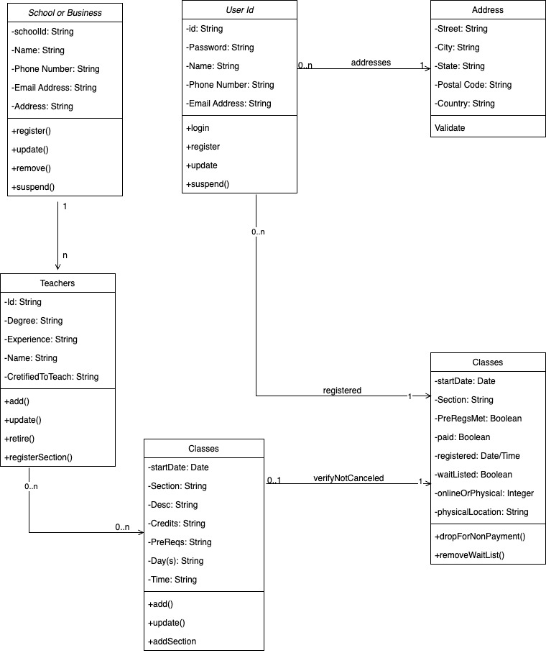
UML Diagrams Part 1 - Class

Slide 5
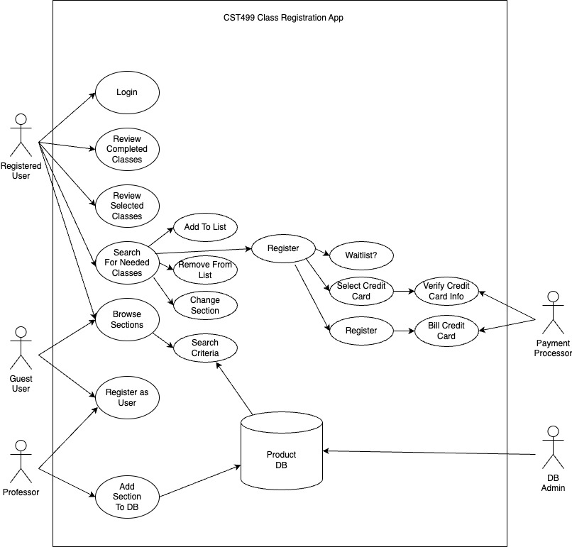
UML Diagrams Part 2 – use case

Slide 6

User Interface
Using the XAMPP stack to develop and run on my Macbook
Could be run on Windows or Linux as well
Comprised of Apache Web Server, MySQL database
Application being written in PHP

Slide 7
User interface design
The main landing page has register and login functions only, until a user registers themselves and logs in
Once logged in, the landing page menu changes
Can now see what the logged in user is currently registered for, as well as allowed to register for more

Slide 8

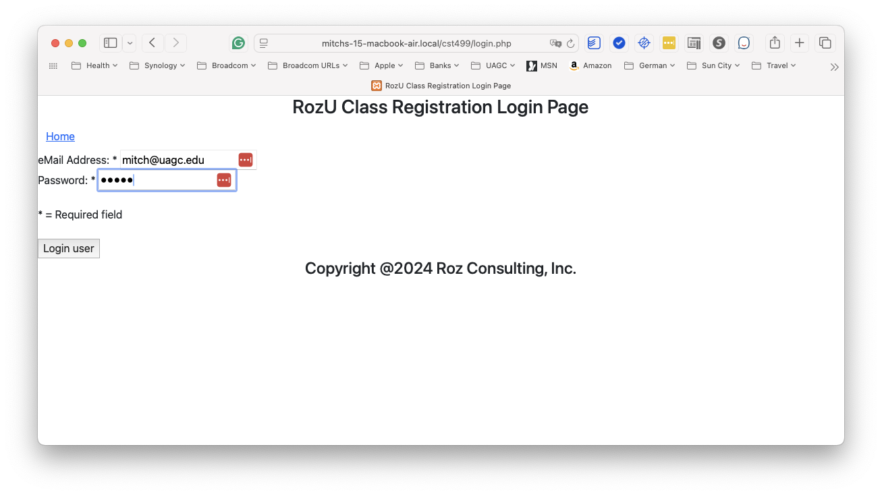
User login

Slide 9
database
Used MySQL and administration is performed via phpMyAdmin
Primary keys to ensure no duplicates, and indexes for performance when JOIN’ing to other tables
Class registration is as easy as clicking the class hyperlink to register and deregister
“Specify a primary key for every table using the most frequently queried column or columns” (MySQL, 2024, para. 1)

Slide 10
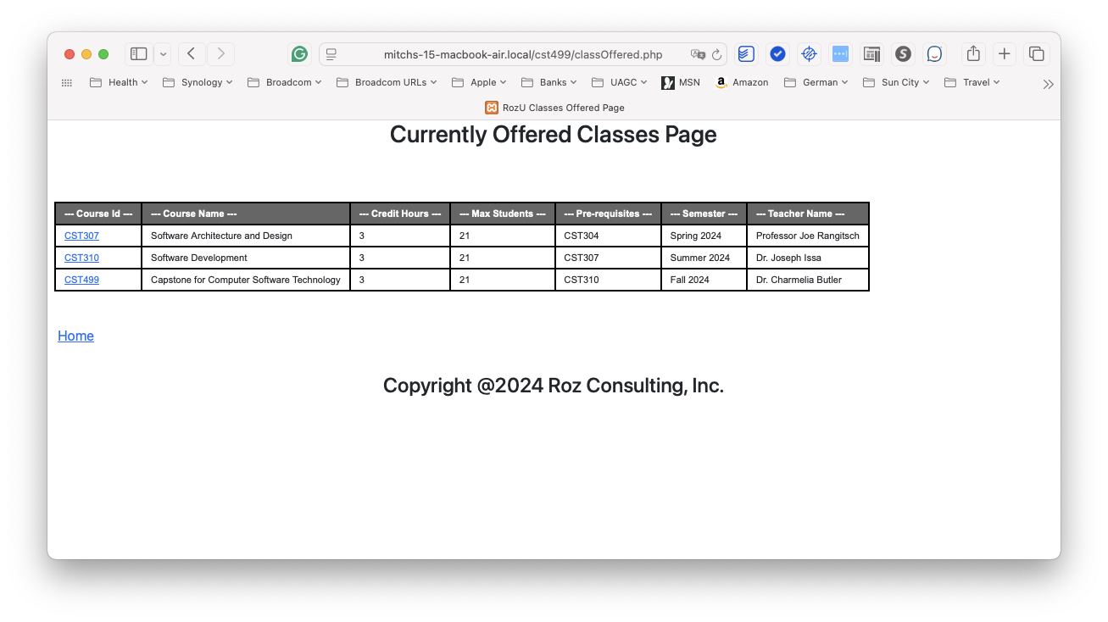
Class registration

Slide 11
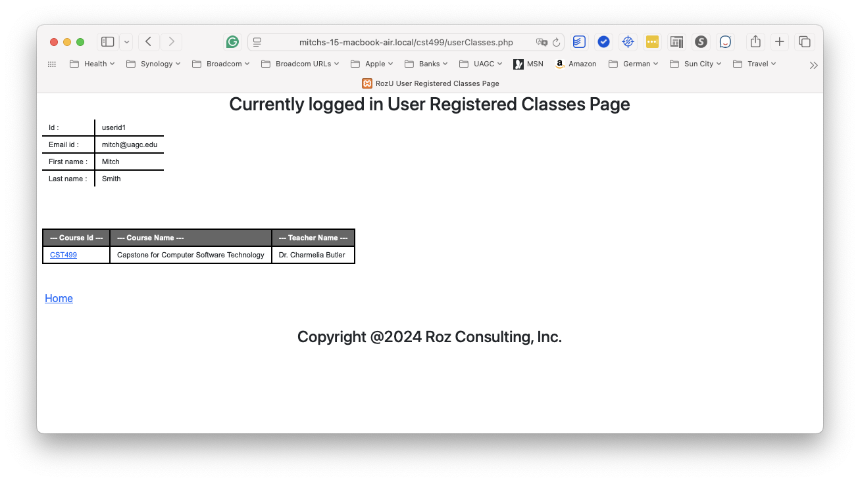
Class deregistration

Slide 12
Php code
Standalone class to interface to the database using PHP Document Object (PDO) access
Created a php file per screen
When needed, pass data using session variables

Slide 13
references
Krüger, G. & Lane, C. (2023). How to Write an SRS Document (Software Requi re ments Specification Document). Perforce.com. https://www.perforce.com/blog/alm/how-write-software-requirements-specification-srs-document
MySQL. (2024). Best Practices for InnoDB Tables. MySQL.com. https://dev.mysql.com/doc/refman/8.4/en/innodb-best-practices.html

